Slide 1

Web Application Development
COMP-229
Fall 2023

Slide 2
Creating a new Vite app
Create a folder call mern_skeleton
For this, you need to have installed npm or yarn.
Open your terminal and write the following command:
yarn create vite app-name --template react # For yarn npm create vite@latest app-name --template react # For npm
In this case my app-name is client, so I will have:
yarn create vite client --template react # For yarn npm create vite@latest client --template react # For npm

Slide 3
Setup
Enter to the project folder and install the dependencies:
cd client
yarn # For yarn npm install # For npm
You should have the following folder structure:

Slide 4
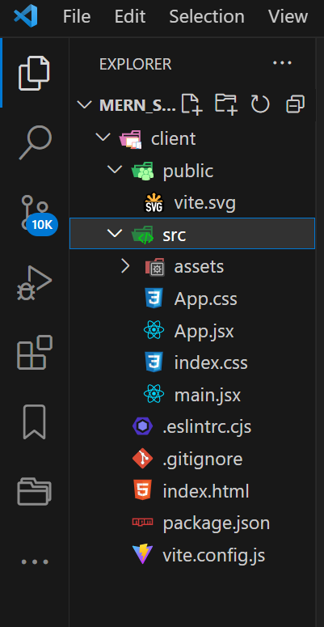
Setup contd.

Slide 5
Configuring Vite
We’re going to configure vite, open the file vite.config.js
and overwrite its content with the following:
import { defineConfig } from "vite";
import react from "@vitejs/plugin-react";
export default defineConfig({
plugins: [react()],
build: {
manifest: true,
rollupOptions: {
input: "./src/main.jsx",
},
},
});

Slide 6
Configuring vite.
This is to set the bundle’s entry point to src/main.jsx instead of the default index.html.

Slide 7
Creating the server
Navigate to the root folder, type the following command
touch server.js
NOTE: If touch does not work for you, create the file server.js manually in the root folder (mern_skeleton)
yarn add express # For yarn npm i express # For npm
In the server.js file we will write:
const express = require("express");
const path = require("path");
const app = express();
app.use("/", express.static(path.join(__dirname, "public")));
app.get("/api/v1", (req, res) => {
res.json({
project: "React and Express Boilerplate",
from: "Vanaldito",
});
});
app.get("/*", (_req, res) => {
res.sendFile(path.join(__dirname, "public", "index.html"));
})
const { PORT = 5000 } = process.env;
app.listen(PORT, () => {
console.log();
console.log(` App running in port ${PORT}`);
console.log();
console.log(` > Local: \x1b[36mhttp://localhost:\x1b[1m${PORT}/\x1b[0m`);
});

Slide 8
Importing Required Modules:
express: To create an Express application.
path: To work with file and directory paths.
Creating an Express Application:
const app = express();: Initializes the Express application.
Serving Static Files:
app.use("/", express.static(path.join(__dirname, "public")));: This middleware serves static files from the public directory when the root URL (/) is accessed.
API Endpoint:
app.get("/api/v1", (req, res) => {...});: Defines a route handler for GET requests to /api/v1.
res.json({...});: Sends a JSON response with details about the project.

Slide 9
5. Catch-All Route for Client-Side Routing:
app.get("/*", (_req, res) => {...});: Defines a catch-all route for all other requests (not matching any previous routes).
res.sendFile(path.join(__dirname, "public", "index.html"));: Serves the index.html file from the public directory. This is useful for single-page applications (SPAs) where the client-side routing is handled by JavaScript.
6. Starting the Server:
const { PORT = 5000 } = process.env;: Sets the PORT variable to the value of process.env.PORT if it exists; otherwise, it defaults to 5000.
app.listen(PORT, () => {...});: Starts the Express server, listening on the specified PORT.
console.log(...): Prints messages to the console, indicating that the server is running and providing the URL where it can be accessed.

Slide 10
Summary
Static File Serving: Serves static files from the public directory.
API Endpoint: Provides a simple JSON response at /api/v1.
Catch-All Route: Serves index.html for all other routes, supporting single-page applications.
Server Initialization: Starts the server on a specified port, defaulting to 5000 if not set in the environment variables, and logs the server's address to the console.

Slide 11
This will allow us to use our frontend in the backend. But we have a new problem: the static assets (images, videos, etc.). To solve it, we need to create a middleware to manage the assets. Run the following commands: from the root folder (i.e from the terminal):
Open a new terminal
mkdir server touch server/assets-router.js
NOTE: If touch does not work for you, right click on the server folder and create the assets-router.js file.

Slide 12
assets-router.js
Write in the server/assets-router.js file:
const express = require("express");
const router = express.Router();
const imageRegex = /\/.+\.(svg|png|jpg|png|jpeg)$/; // You can add other image formats
const videoRegex = /\/.+\.(mp4|ogv)$/
router.get(imageRegex, (req, res) => {
const filePath = req.path;
res.redirect(303, `http://localhost:3000/src${filePath}`);
});
router.get(videoRegex, (req, res) => {
const filePath = req.path;
res.redirect(303, `http://localhost:3000/src${filePath}`);
});
module.exports = router;

Slide 13
Import Express and create a router:
const express = require("express");
const router = express.Router();
Define regex patterns for images and videos:
const fileRegexes = [
/\/.+\.(svg|png|jpg|jpeg)$/, // Image formats
/\/.+\.(mp4|ogv)$/ // Video formats
];
Iterate over the regex patterns and create a route for each:
fileRegexes.forEach(regex => {
router.get(regex, (req, res) => {
const filePath = req.path;
res.redirect(303, `http://localhost:3000/src${filePath}`);
});
});
Export the router:
module.exports = router;

Slide 14
server.js file
And add the following lines in the server.js file:
const assetsRouter = require("./server/assets-router");app.use("/src", assetsRouter);

Slide 15
Updated server.js contd.
const express = require("express");
const path = require("path");
const app = express();
const assetsRouter = require("./server/assets-router");
app.use("/src", assetsRouter);
app.use("/", express.static(path.join(__dirname, "public")));
app.get("/api/v1", (req, res) => {
res.json({
project: "React and Express Boilerplate",
from: "Vanaldito",
});
});
app.get("/*", (_req, res) => {
res.sendFile(path.join(__dirname, "public", "index.html"));
})
const { PORT = 5000 } = process.env;
app.listen(PORT, () => {
console.log();
console.log(` App running in port ${PORT}`);
console.log();
console.log(` > Local: \x1b[36mhttp://localhost:\x1b[1m${PORT}/\x1b[0m`);
});

Slide 16
Nodemon and Concurrently
Install nodemon for live reloading of the server in the root folder and client folder:
yarn add --dev nodemon or npm i --save-dev nodemon
Install concurrently globally to run commands simultaneously both in the root folder and client folder:
yarn add global concurrently or npm i -g concurrently

Slide 17
Running the app
Add the next script in the package.json file:
"dev": "concurrently 'vite' 'nodemon server.js’”

Slide 18
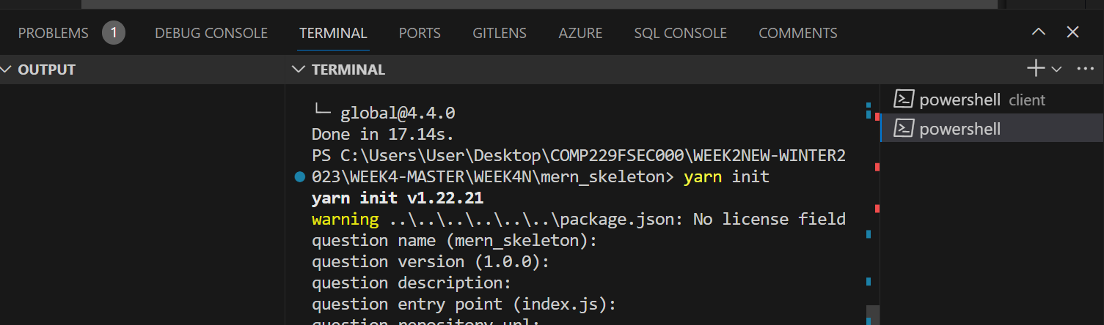
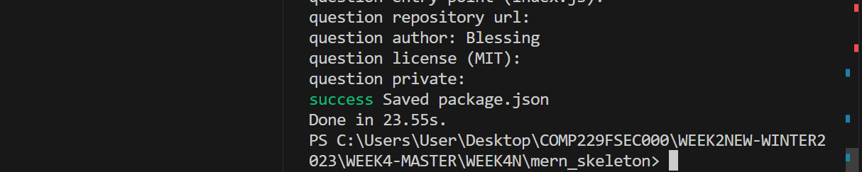
Installing vite globally
Run, yarn init in the root folder to create the package.json
i.e mern_skeleton

Slide 19
Add the following in the root folder i.e, mern_skeleton
yarn global add vite
yarn add concurrently --dev
Once the installation is complete, update your "dev" script in the package.json file to use concurrently:
"dev": "concurrently 'vite' 'nodemon server.js’ »

Slide 20
Updated the package.json in the client
{
"name": "client",
"private": true,
"version": "0.0.0",
"type": "module",
"scripts": {
"dev": "concurrently 'vite' \"nodemon ../server.js\"",
"build": "vite build",
"lint": "eslint src --ext js,jsx --report-unused-disable-directives --max-warnings 0",
"preview": "vite preview"
},
"dependencies": {
"global": "^4.4.0",
"react": "^18.2.0",
"react-dom": "^18.2.0"
},
"devDependencies": {
"@types/react": "^18.0.37",
"@types/react-dom": "^18.0.11",
"@vitejs/plugin-react": "^4.0.0",
"concurrently": "^8.2.0",
"eslint": "^8.38.0",
"eslint-plugin-react": "^7.32.2",
"eslint-plugin-react-hooks": "^4.6.0",
"eslint-plugin-react-refresh": "^0.3.4",
"nodemon": "^2.0.22",
"vite": "^4.3.9"
}
}

Slide 21
Updated Package.json server side
{
"name": "mern_skeleton",
"version": "1.0.0",
"main": "index.js",
"author": "Blessing",
"license": "MIT",
"devDependencies": {
"concurrently": "^8.2.0",
"nodemon": "^2.0.22"
},
"scripts": {
"dev": "concurrently 'vite' \"nodemon server.js\"",
"build": "vite build",
"lint": "eslint src --ext js,jsx --report-unused-disable-directives --max-warnings 0",
"preview": "vite preview"
},
"dependencies": {
"global": "^4.4.0"
}
}

Slide 22
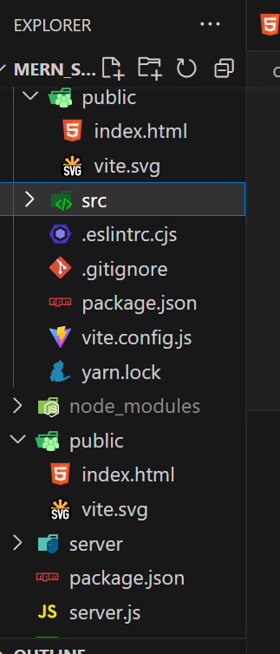
Copy the public folder from the client folder and paste in the root folder

Slide 23
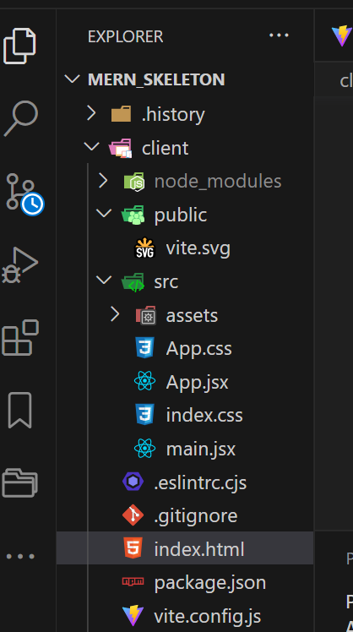
Copy the index.html file from the client folder to the public folder in the root folder

Slide 24
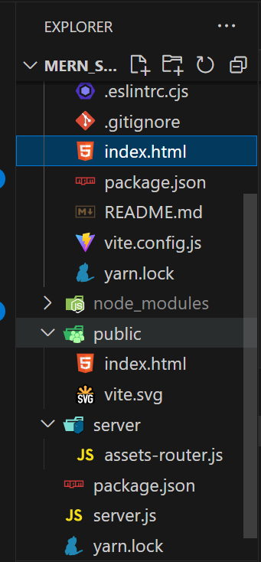

Slide 25
Update the index.html file in the client folder as follows:
<!DOCTYPE html>
<html lang="en">
<head>
<meta charset="UTF-8" />
<link rel="icon" type="image/svg+xml" href="/favicon.svg" />
<meta name="viewport" content="width=device-width, initial-scale=1.0" />
<title>Vite App</title>
</head>
<body>
<div id="root">Welcome to Frontend
</div>
</body>
</html>

Slide 26
Updated index.html file in the root folder is as follows:
<!DOCTYPE html>
<html lang="en">
<head>
<meta charset="UTF-8" />
<link rel="icon" type="image/svg+xml" href="/favicon.svg" />
<meta name="viewport" content="width=device-width, initial-scale=1.0" />
<title>Vite App</title>
</head>
<body>
<div id="root">Hello World</div>
</body>
</html>

Slide 27
Install concurrently
Since the Frontend and Backend will run concurrently, we will need to install concurrently at the root folder
yarn global add concurrently
OR
npm install -g concurrently

Slide 28
run the app command:
cd to the client folder
Run the application since we are running it concurrently it will display the port number where both frontend and backend is running:
yarn dev or npm run dev

Slide 29
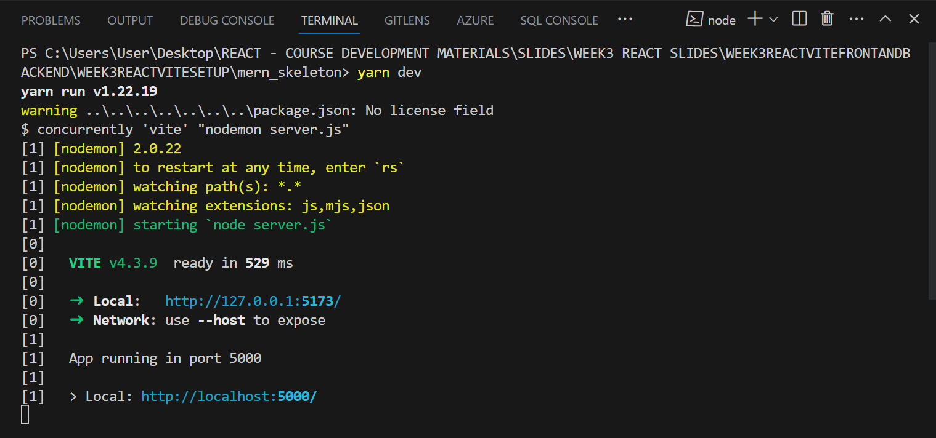

Slide 30
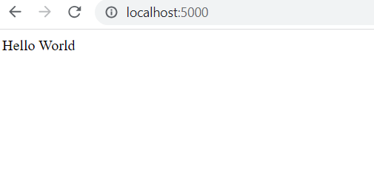
Output in the browser
The server is running on:
http://localhost:5000/

Slide 31
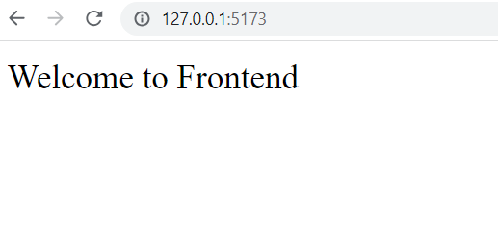
Output in the Browser
The Frontend is running on:
http://127.0.0.1:5173/

